Slide 1


Applied Millimeter Wave Radar Vibrometry
Ph.D. Final Exam
Electrical and Computer Engineering Department, Duke University
Jessica Centers, Ph.D. candidate advised by Dr. Jeffrey Krolik
April 5th, 2023

Slide 2
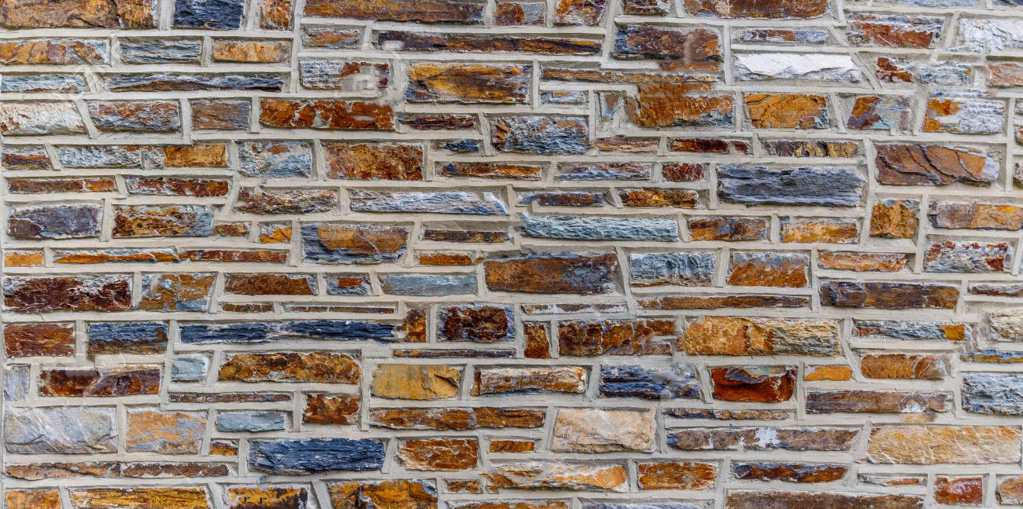
Outline
How can mmW radar vibrometry help vehicles communicate?
Can mmW radar vibrometry lead to novel speech analysis systems?
Why mmW radar vibrometry?
What are the key take aways?
-Accessible Vibrometry
-mmW Radar Vibrometry
-Contributions
-Radar Vibrometry for Connected Vehicles
-Vibrational Radar Backscatter Communication
-Modeling VRBC Return
-VRBC Processing Chain with Details and Examples
-Handling Resonant Transponding Surfaces
-Upper Bound on VRBC Data Rate
-Platform Noise
-Larynx Vibrational Analysis
-Human Speech Applications
-Summary of Work
-Future Work
-Acknowledgements

Slide 3
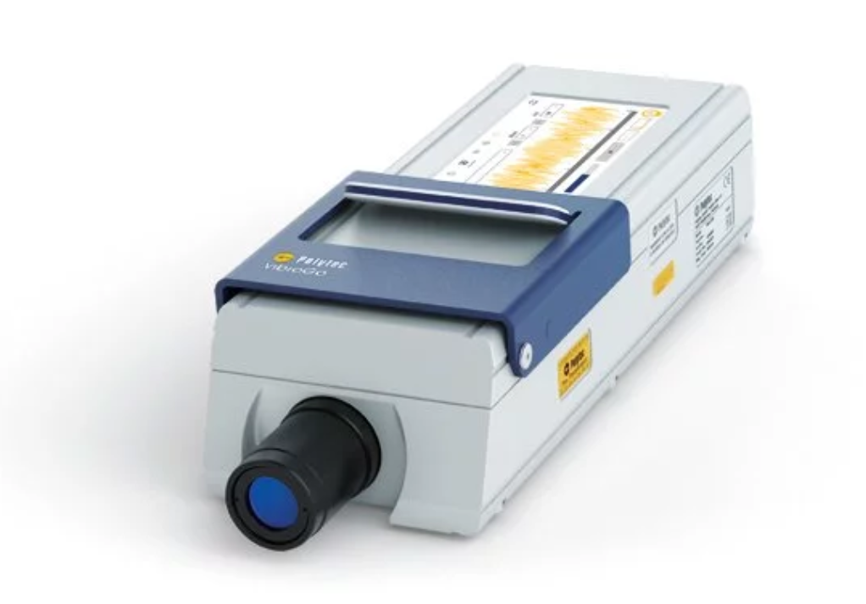
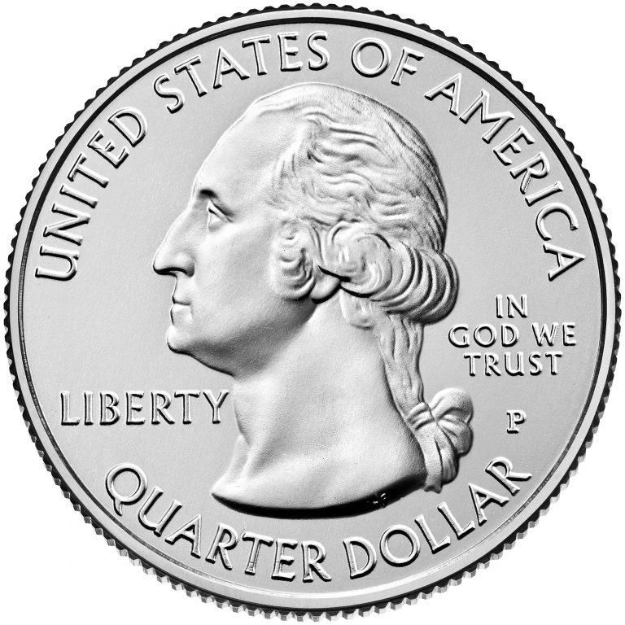
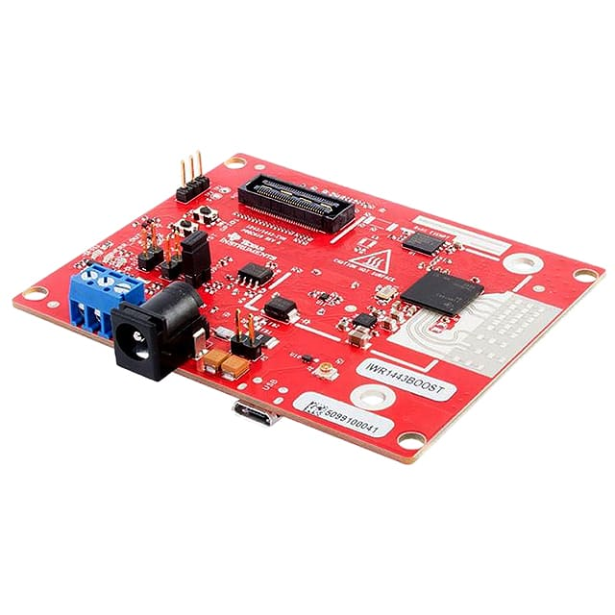
Accessible Vibrometry with mmW Radars
Vibrometry historically provides accurate, stand-off vibrational measurements.
Automotive Noise, Vibration, and Harshness (NVH) Measurements ^{[13]}
Health Monitoring of Architectural Structures ^{[15]}
Turbine Vibrational Analysis ^{[11]}
Loudspeaker Quality Testing ^{[12]}
….
Understanding Crab Courtship ^{[16]}
Laser Doppler vibrometers (LDVs) have
been the primary sensing solution.
Uses interferometry to detect Doppler shifts
Millimeter wave (mmW) radars are an
accessible alternative.
Few $100s vs $10,000s
Smaller size, weight, and power (SWaP)
Goal: Develop mmW radar vibrometry techniques in the application spaces of wireless communication and non-acoustic speech analysis systems.
Polytec VibroGo ^{[9]}
TI IWR1443 mmW Radar Evaluation Module ^{[25]}

Slide 4
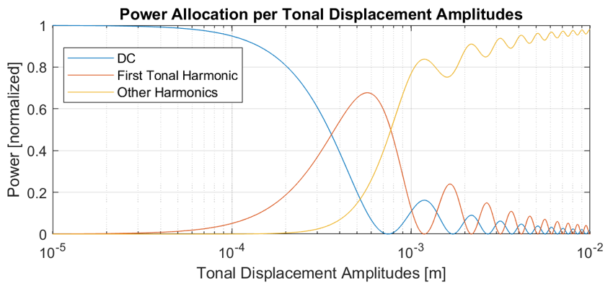
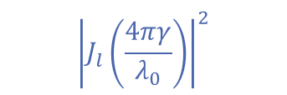
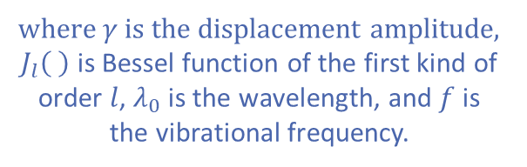
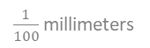
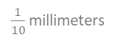
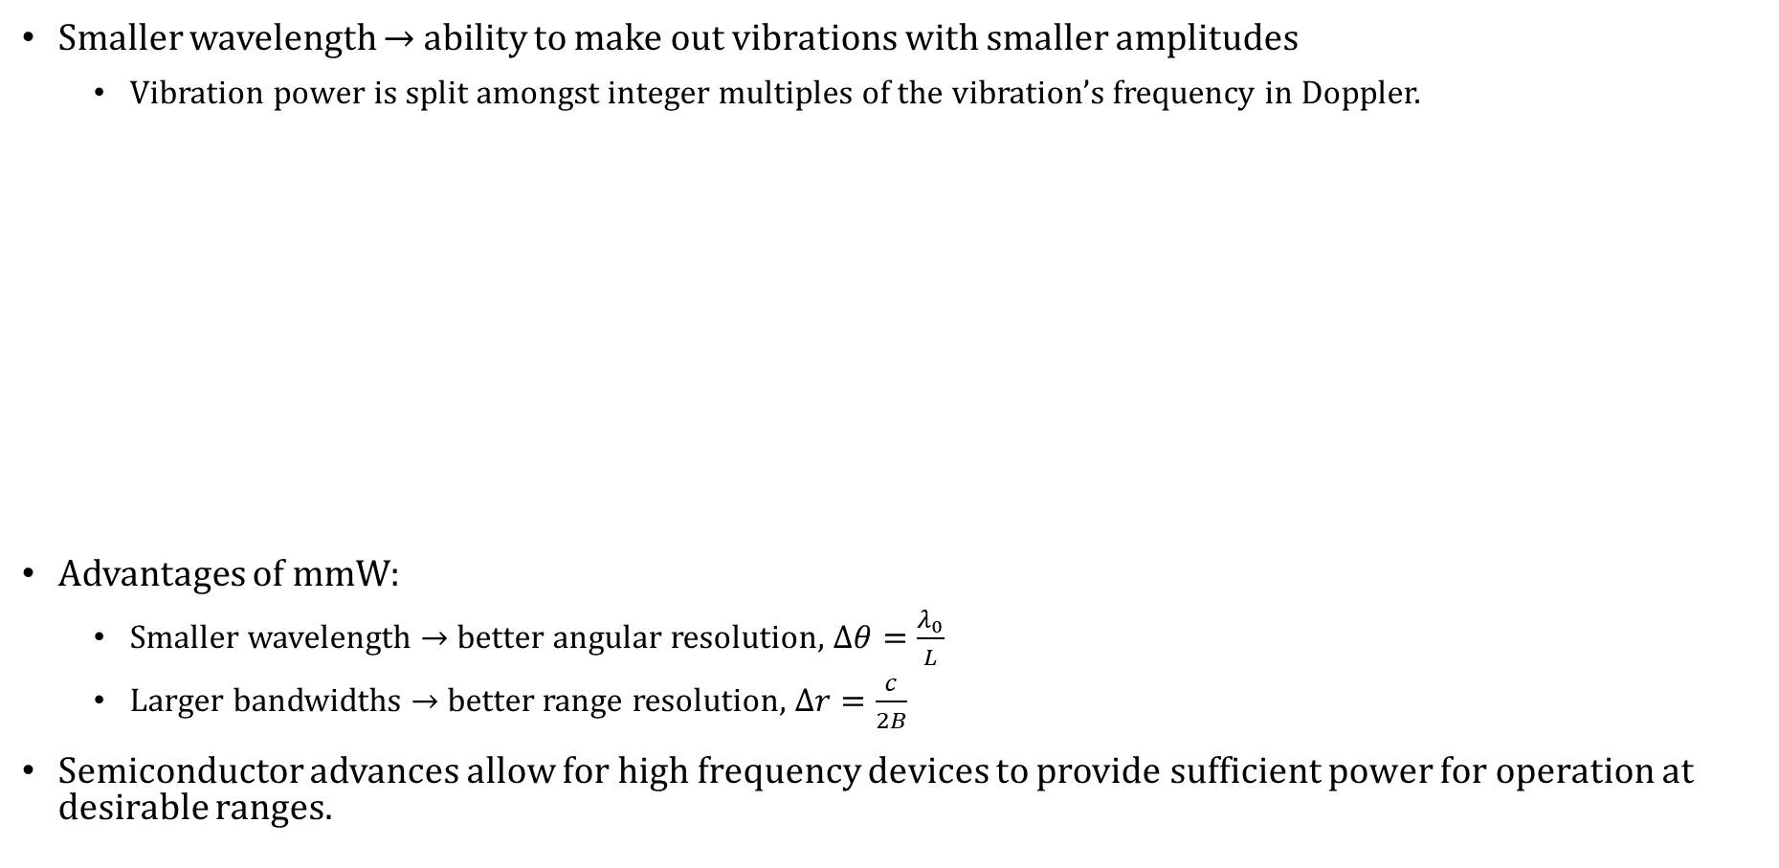
Why Millimeter Wave (mmW) Radar Vibrometry?
Smaller wavelength $→$ ability to make out vibrations with smaller amplitudes
Vibration power is split amongst integer multiples of the vibration’s frequency in Doppler.
Advantages of mmW:
Smaller wavelength $→$ better angular resolution, $∆θ=\frac{λ_{0}}{L}$
Larger bandwidths $→$ better range resolution, $∆r=\frac{c}{2B}$
Semiconductor advances allow for high frequency devices to provide sufficient power for operation at desirable ranges.
Power at bulk Doppler frequency $±lf$ Hz is
$${\left|J_{l}\left(\frac{4πγ}{λ_{0}}\right)\right|}^{2}$$
similar to narrowband FM
where $γ$ is the displacement amplitude, $J_{l}\left( \right)$ is Bessel function of the first kind of order $l$, $λ_{0}$is the wavelength, and $f$ is the vibrational frequency.
$\frac{1}{100}$ millimeters
$\frac{1}{10}$ millimeters
millimeters
Notes:
Before I get into the two applications considered in my dissertation, let me explain why radar’s at mmW are specifically opening up the door to this sort of work. In other words, why haven’t other radars solved these problem…

Slide 5
Dissertation’s Contributions
Vibrational Radar Backscatter Communication (VRBC)
– Novel Communication System
Conceived of and developed a novel wireless communication system termed Vibrational Radar Backscatter Communication (VRBC) that proves particularly beneficial when mmW radars are already present for sensing.
Developed the signal model and processing chain for detecting, isolating, and decoding modulated vibrational signals from a VRBC transponder.
Analyzed the trade-offs of VRBC system design choices in transponder, messaging scheme, and radar parameters.
Provided a useful theoretical upper bound on VRBC rate.
Performed sequence detection using the Viterbi algorithm to improve the observed rate when resonant transponding surfaces are used.
Implemented VRBC using affordable, off-the-shelf products.
J. Centers and J. Krolik, “Vibrational Radar Backscatter Communications,” in 2021 55th Asilomar Conference on Signals, Systems, and computers, pp. 1086-1090, 2021.
J. Centers and J. Krolik, “Vibrational Radar Backscatter Communications Using Resonant Transponding Surfaces,” in 2022 IEEE 12th Sensor Array and Multi-channel Signal Processing Workshop (SAM), pp. 77-75, 2022.
J. Centers and J. Krolik, “Multi-User Methods for Vibrational Radar Backscatter Communications,” in 2023 IEEE International Conference on Acoustics, Speech, and Signal Processing, [ACCEPTED], 2023.
J. Centers and J. Krolik, “Vibrational Radar Backscatter Communications Theory and Bound,” IEEE Transactions on Radar Systems, [PENDING REVIEW], 2023.

Slide 6
Dissertation’s Contribution
Non-Acoustic Speech Analysis Systems
– Preliminary Exploration
Used mmW radar vibrometry to observe human larynx speech-induced vibrations and compared results to those observed with an expensive LDV.
Explored the use of larynx mmW radar vibrometry for context-blind speaker ID.
Processing Methods for mmW Radar Vibrometry
– Impact on the Broader Field
Veered from convention range-Doppler assumptions to better capture vibrational effects on the return.
Implemented a system identification method for estimating a vibrating surface’s response.
Evaluated clutter filtering effects on vibrational return and provided a solution to minimize resulting errors on the return’s phase.

Slide 7
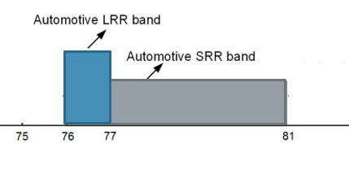
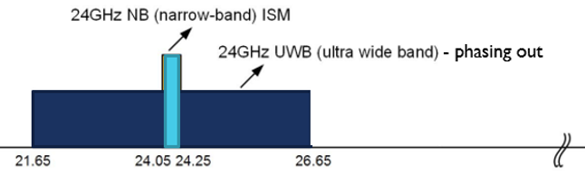
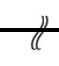
Radar Vibrometry for Connected Vehicles
Comms. and sensing compete for radio frequency (RF) spectrum in transportation scenarios.
Connected Vehicle Solutions: allow vehicles to share warnings or situational information
Automotive mmW Radars: enable advanced driver assistance systems (ADAS) like lane change assistance and blind spot detection
Aug. 2022: US Court of Appeals agrees that connected vehicles are falling short ^{[85]}
1999: FCC gave Intelligent Transportation Systems (ITS) the 5.9 GHz band
2019: FCC recognized that “no commercially-marketed vehicles used the 5.9 GHz band to provide vehicle safety features”
Our Approach: Allow commonplace automotive mmW radars be used to also provide communication channels rather than restrict them.
Federal Communications Commission (FCC) Spectrum Allocations
, r > 100 m
Remaining ITS band
24 GHz NB
Automotive LRR band
24 GHz WB – phasing out
, r < 100 m
ITS band – now shared with unlicensed Wi-Fi
(as of Aug. 2022)
Automotive SRR band
5.85
f
[GHz]
5.925
5.925
5.925
5.895

Slide 8
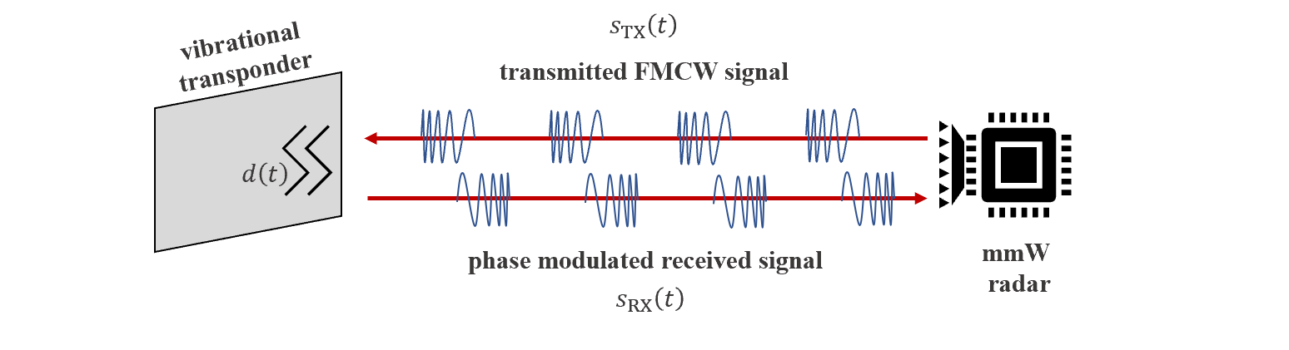
Vibrational Radar Backscatter Communications for X2V
Vibrating license plates, traffic signs, etc. can relay messages to automotive radars that appear as micro-Doppler (phase changes primarily in slow-time).
Benefits of VRBC to other anything-to-vehicle (X2V) communication solutions:
Zero RF emission from the message source
Simultaneous reception from different range/angles
Low-latency since no scheduling protocols are required
Unaffected radar operation as the waveform is unchanged
Minimal additional infrastructure required
Conventional backscatter comms. at mmW requires complex, expensive retro-directive antenna arrays. ^{[51, 52]}

Slide 9
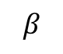
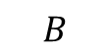
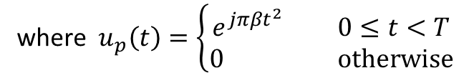
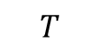
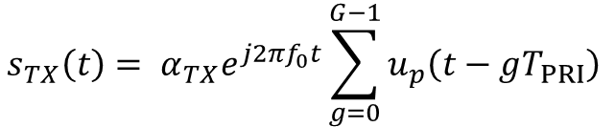
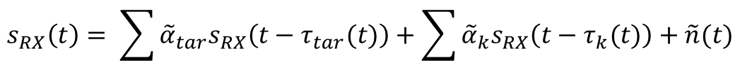
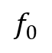
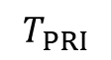
Modeling VRBC Return Assuming FMCW Radar Waveforms
Transmitted waveform is a frequency modulated continuous wave (FMCW)
Received signal contains transponder(s), clutter, and additive white Gaussian noise (AWGN)
$$s_{TX}\left(t\right)= α_{TX}e^{j2πf_{0}t}\sum_{g=0}^{G−1}{u_{p}\left(t−gT_{PRI}\right) }$$
where $u_{p}\left(t\right)=\left\{\begin{matrix}e^{jπβt^{2}} 0≤t<T \\ 0 otherwise\end{matrix}\right.$
where $α_{TX}$ is the TX gain/attenuation
$$G chirps$$
Instantaneous Frequency
$$β$$
$$B$$
$f_{0}$
Time
$$T$$
$$T_{PRI}$$
$$s_{RX}\left(t\right)= \sum{{\tilde{α}}_{tar}s_{RX}\left(t−τ_{tar}(t)\right)}+\sum{{\tilde{α}}_{k}s_{RX}\left(t−τ_{k}(t)\right)}+\tilde{n}(t)$$
where ${\tilde{α}}_{obj}$ following Swerling model (power related to the radar equation)

Slide 10

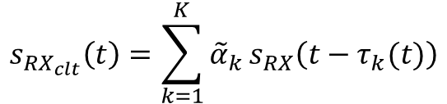

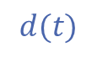
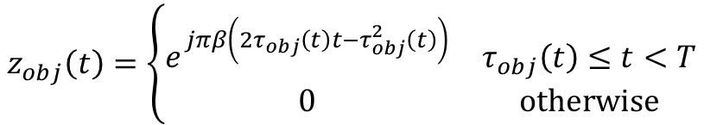
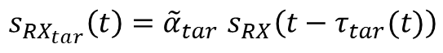

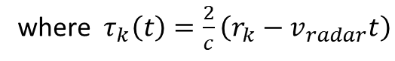

VRBC Signal Model as a Function of Vibrational Displacement
Transponder returns are modeled as flat-fading surfaces such that
Clutter is modeled as a sum of non-target point scatterers
Assuming one-transponder, the full, de-chirped signal at a given receiver element is
$$s_{RX_{tar}}\left(t\right){=\tilde{α}}_{tar}s_{RX}\left(t−τ_{tar}(t)\right)$$
where $τ_{tar}\left(t\right)=\frac{2}{c}\left(r_{tar}+v_{tar}t−v_{radar}t+d\left(t\right)\right)$
$$v_{radar}$$
$$v_{tar}$$
$$d(t)$$
$$s_{RX_{clt}}\left(t\right)=\sum_{k=1}^{K}{{\tilde{α}}_{k}}s_{RX}\left(t−τ_{k}(t)\right)$$
where $τ_{k}\left(t\right)=\frac{2}{c}\left(r_{k}−v_{radar}t\right)$
$$r_{tar}$$
$${s_{TX}\left(t\right)s}_{RX}^{∗}\left(t\right)={\tilde{α}}_{tar}e^{j2πf_{0}τ_{tar}(t)}\sum_{g=0}^{G−1}{z_{tar}\left(t−gT_{PRI}\right)}+\sum_{k=1}^{K}{{\tilde{α}}_{k}e^{j2πf_{0}τ_{k}(t)}\sum_{g=0}^{G−1}{z_{k}\left(t−gT_{PRI}\right)}}+\tilde{n}(t)$$
$$z_{obj}\left(t\right)=\left\{\begin{matrix}e^{jπβ\left(2τ_{obj}\left(t\right)t−τ_{obj}^{2}\left(t\right)\right)} & τ_{obj}\left(t\right)≤t<T \\ 0 & otherwise\end{matrix}\right.$$
Notes:
Transponder return assumes the transponder is primarily within a resolution bin (surface roughness is less than range resolution, orientation is radar-facing, width is less than the beamwidth, ..) This holds true for a license plate at more than a couple meters. This model also holds for retro-directive reflectors.
All ranges, velocities, and displacements are radial. For the clutter, because all points span the full arc of the main beam, we can approximate the Doppler bandwidth due to the radar platform velocity to be 2/lambda v_radar Delta cos(theta).

Slide 11
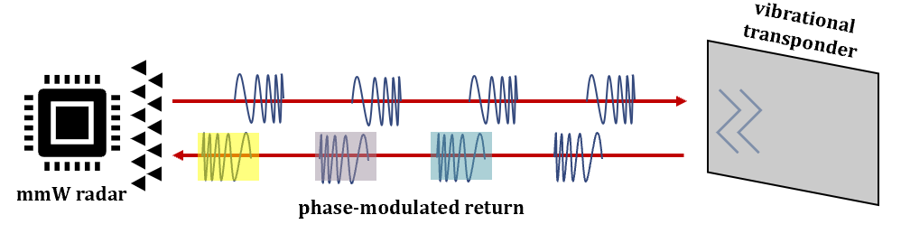
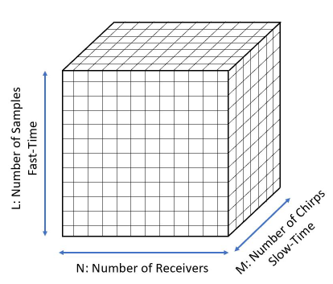
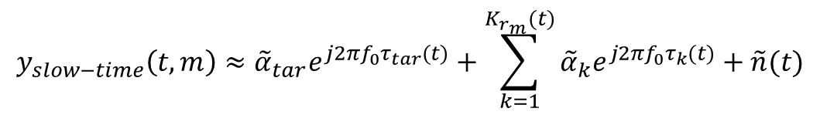
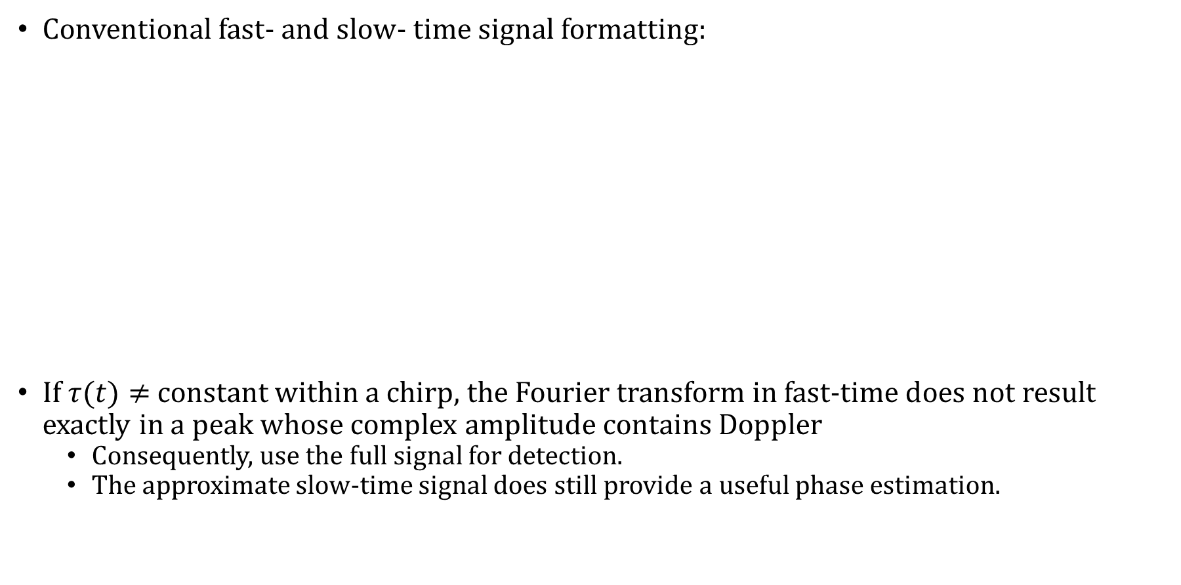
Fast-Time vs Slow-Time Processing
Conventional fast- and slow- time signal formatting:
If $τ(t)≠$ constant within a chirp, the Fourier transform in fast-time does not result exactly in a peak whose complex amplitude contains Doppler
Consequently, use the full signal for detection.
The approximate slow-time signal does still provide a useful phase estimation.
Beamforming
Range Processing
FFT in Fast-Time
# of Channels
# of Chirps
Slow-Time
# of Chirps
Slow-Time
# of Samples within a Chirp
Fast-Time
Range Bins
# of Chirps
Slow-Time
$$y_{slow−time}\left(t,m\right)≈{\tilde{α}}_{tar}e^{j2πf_{0}τ_{tar}(t)}+\sum_{k=1}^{K_{r_{m}}(t)}{{\tilde{α}}_{k}e^{j2πf_{0}τ_{k}(t)}}+\tilde{n}(t)$$
# of Samples within a Chirp
Fast-Time
# of Samples

Slide 12
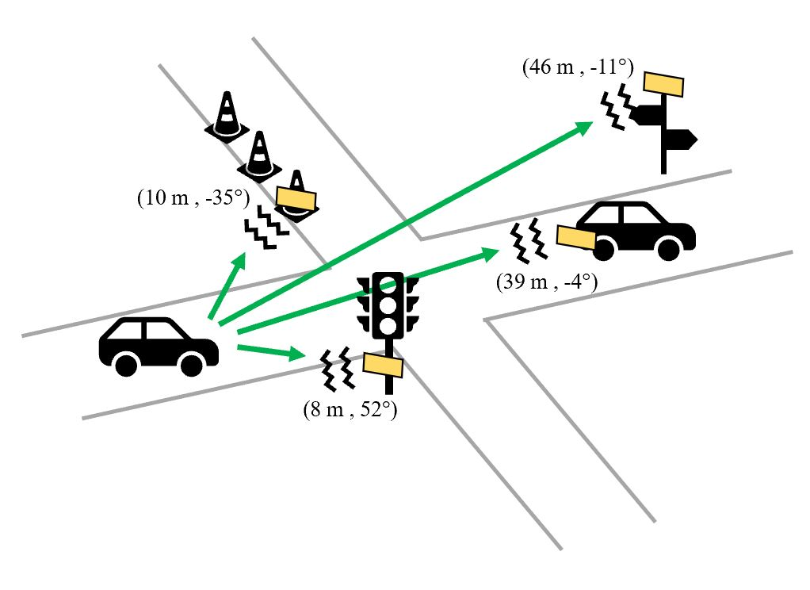
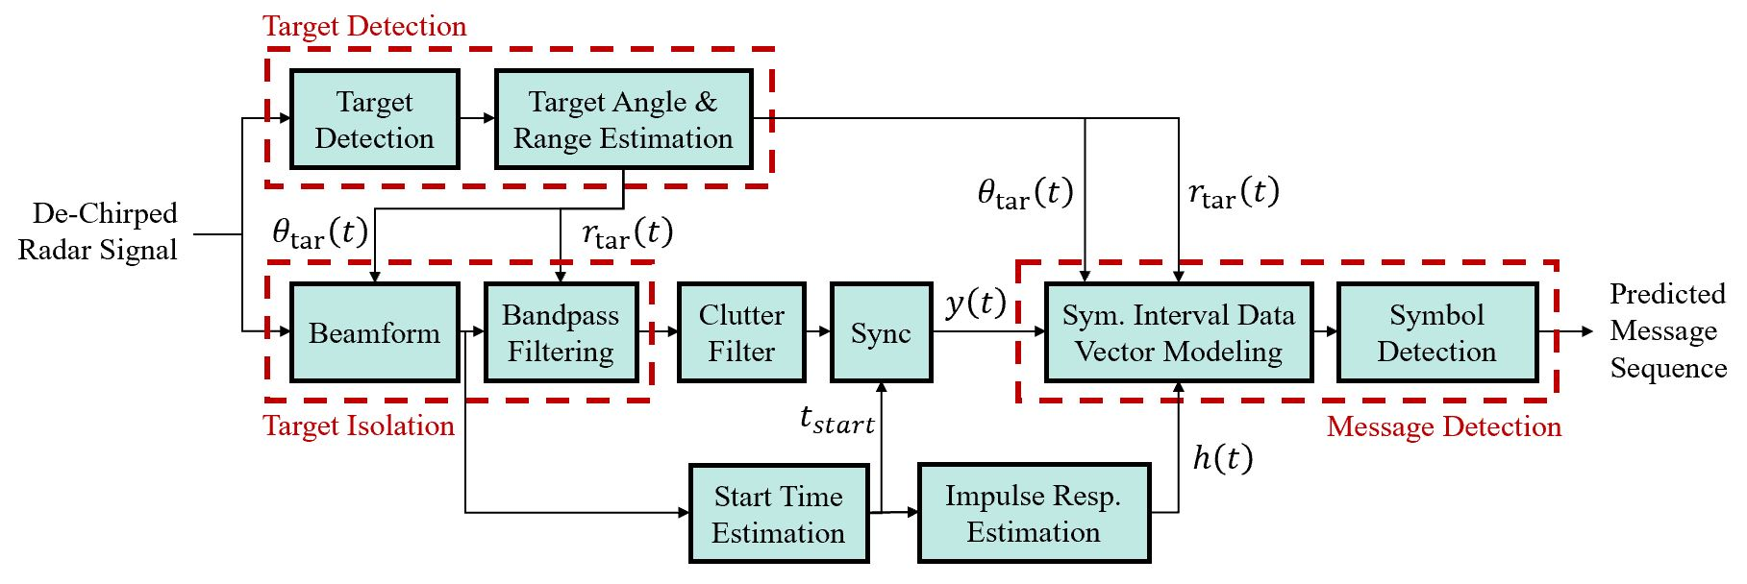

VRBC Signal Processing Chain
Target isolation and message decoding can be completed simultaneously for different transponders detected.
Many of these processing blocks perform the necessary parameter estimations for the classic comms. problem.

Slide 13
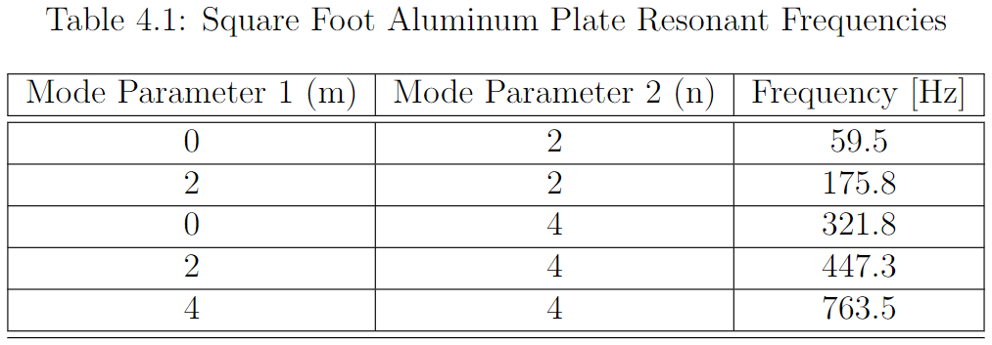
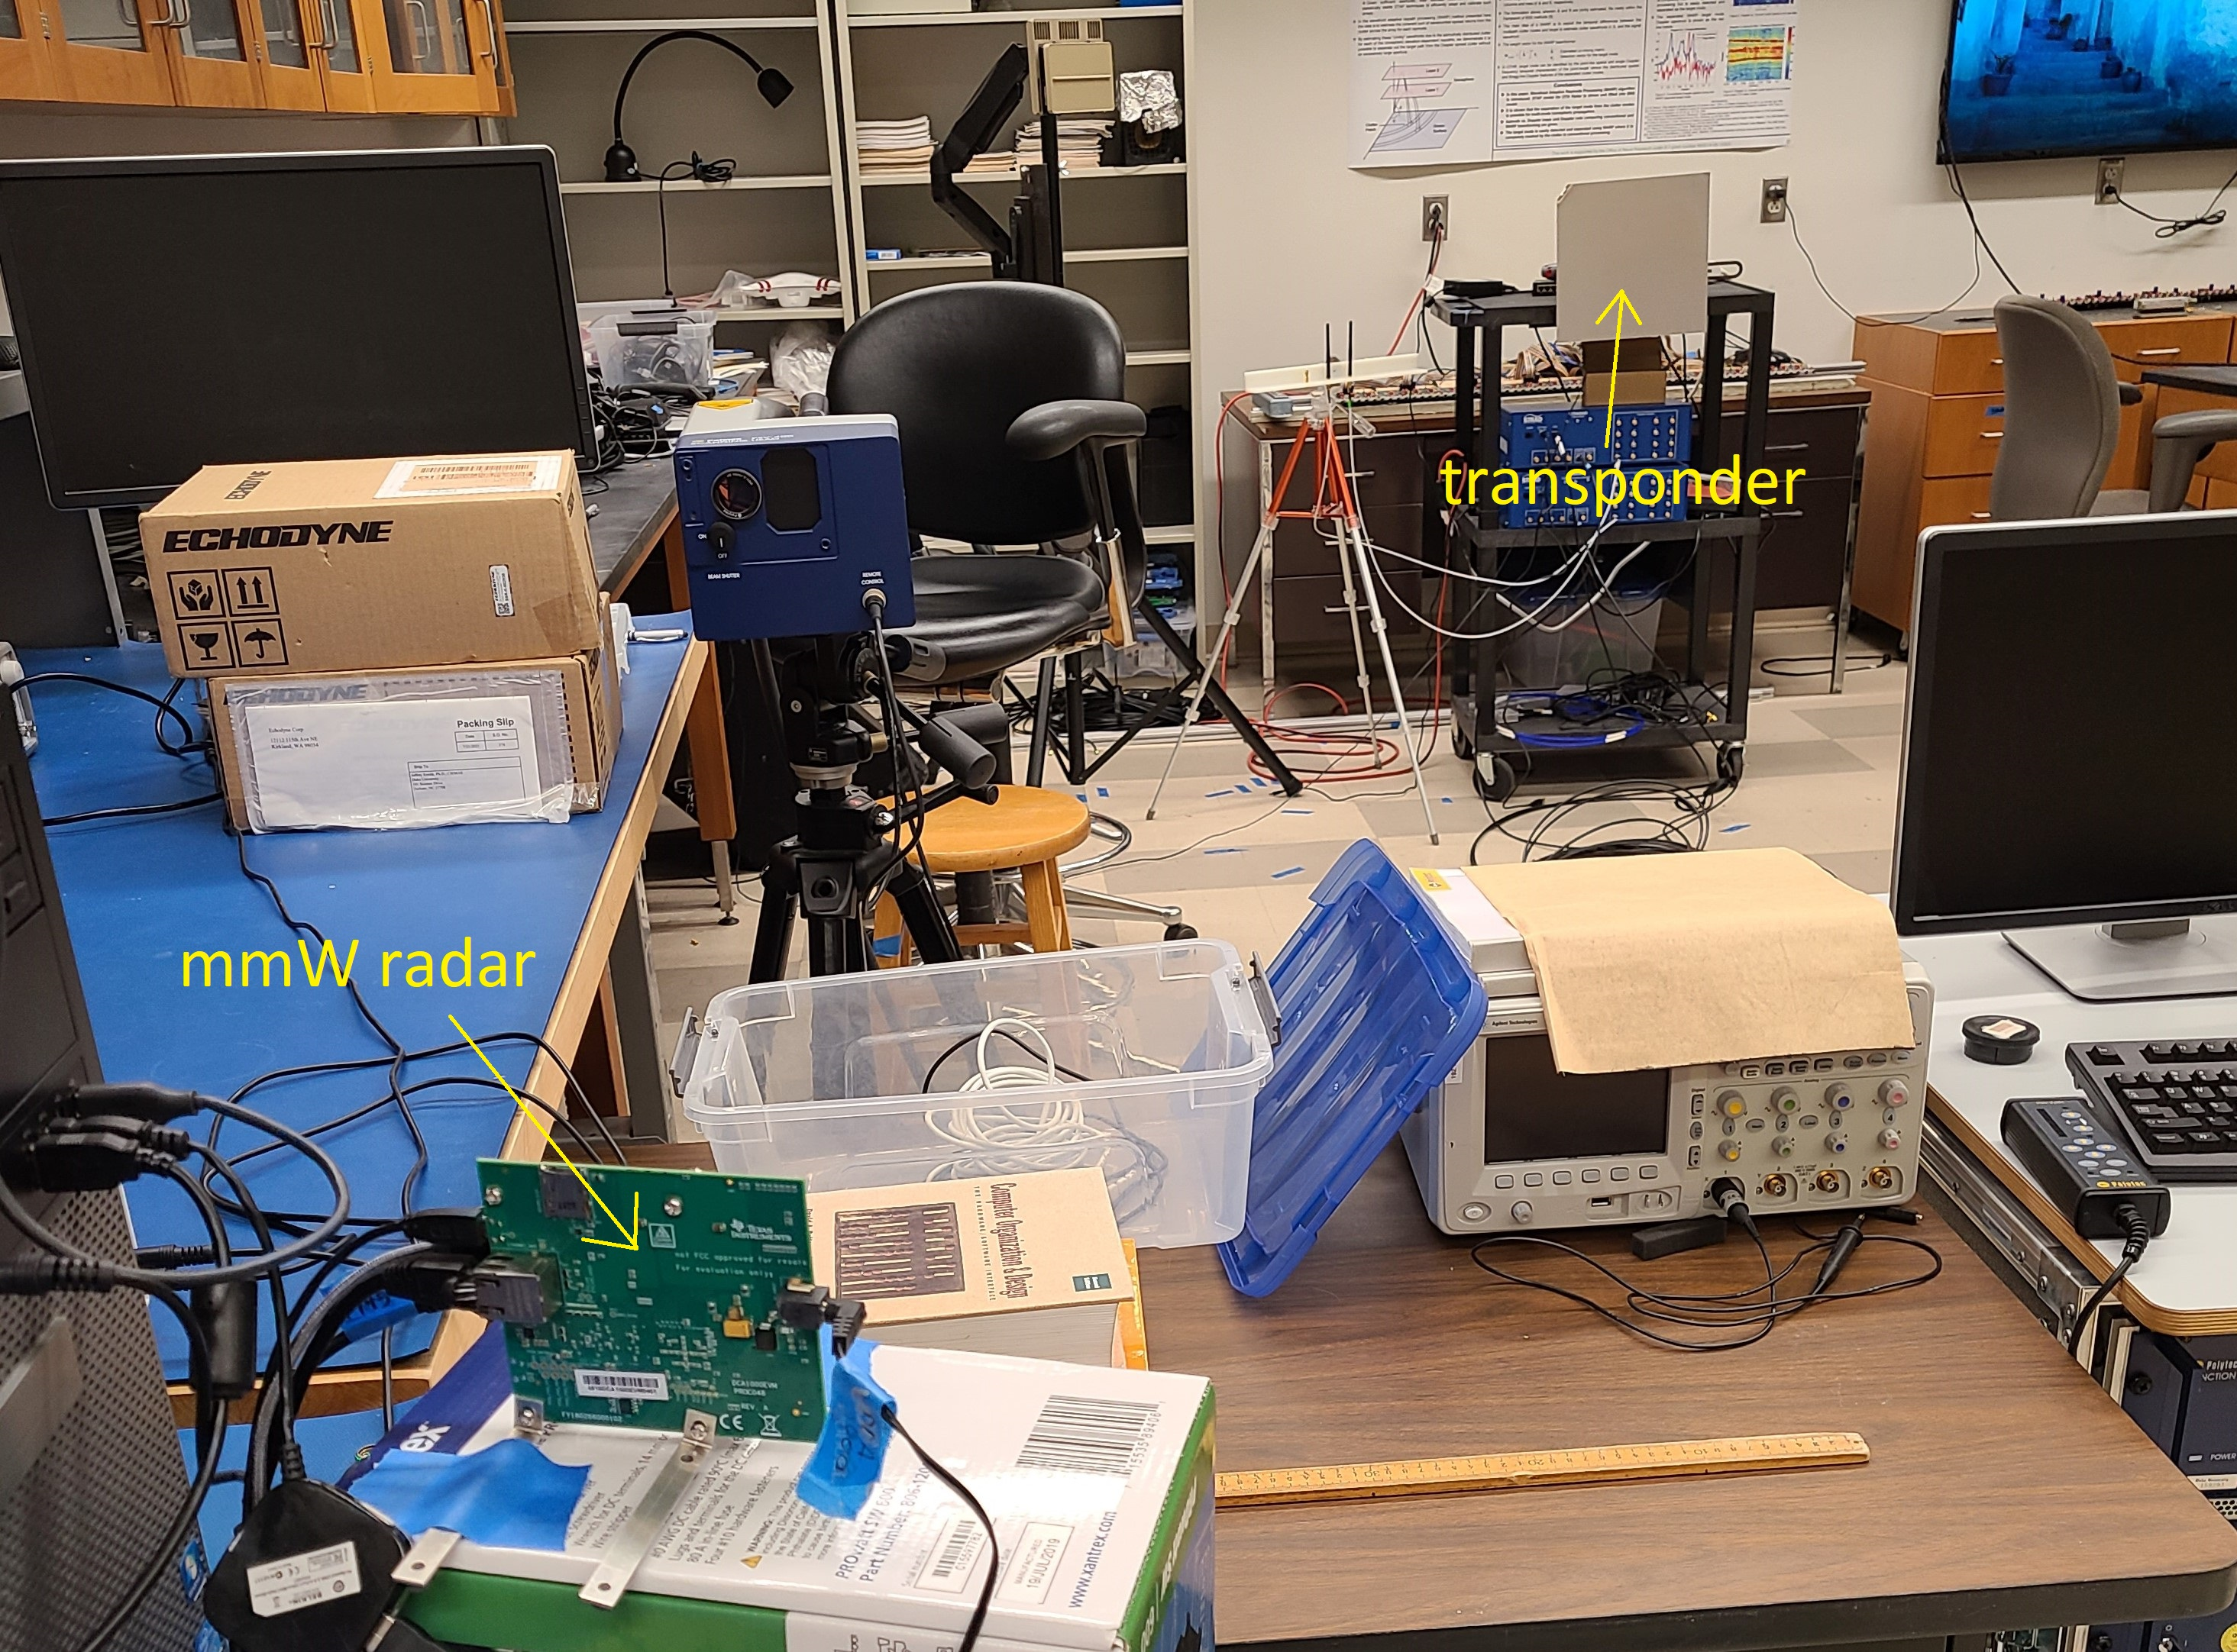
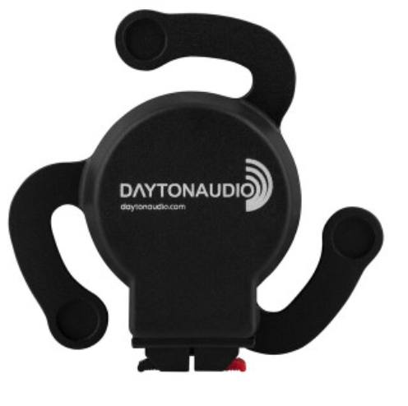
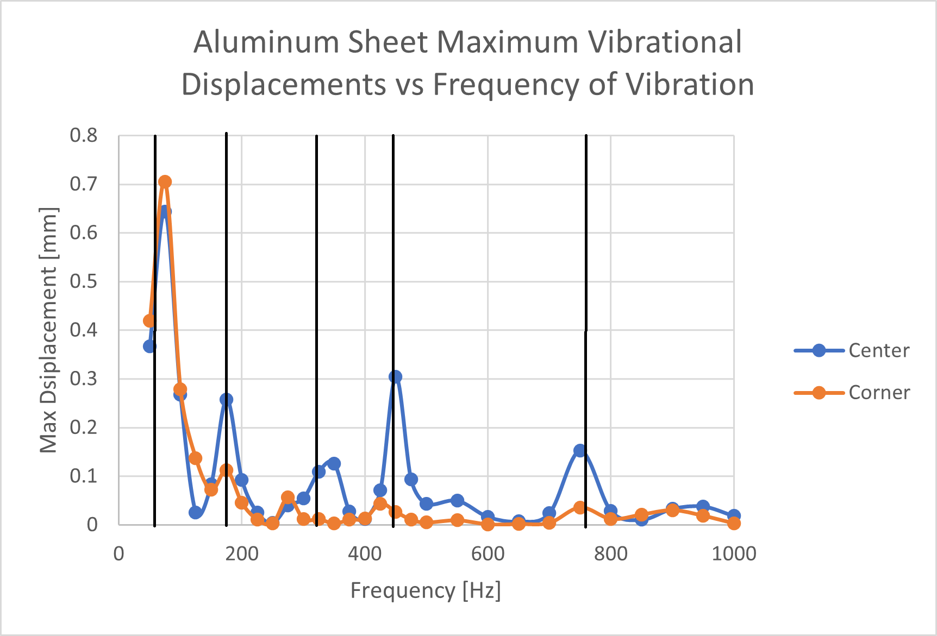
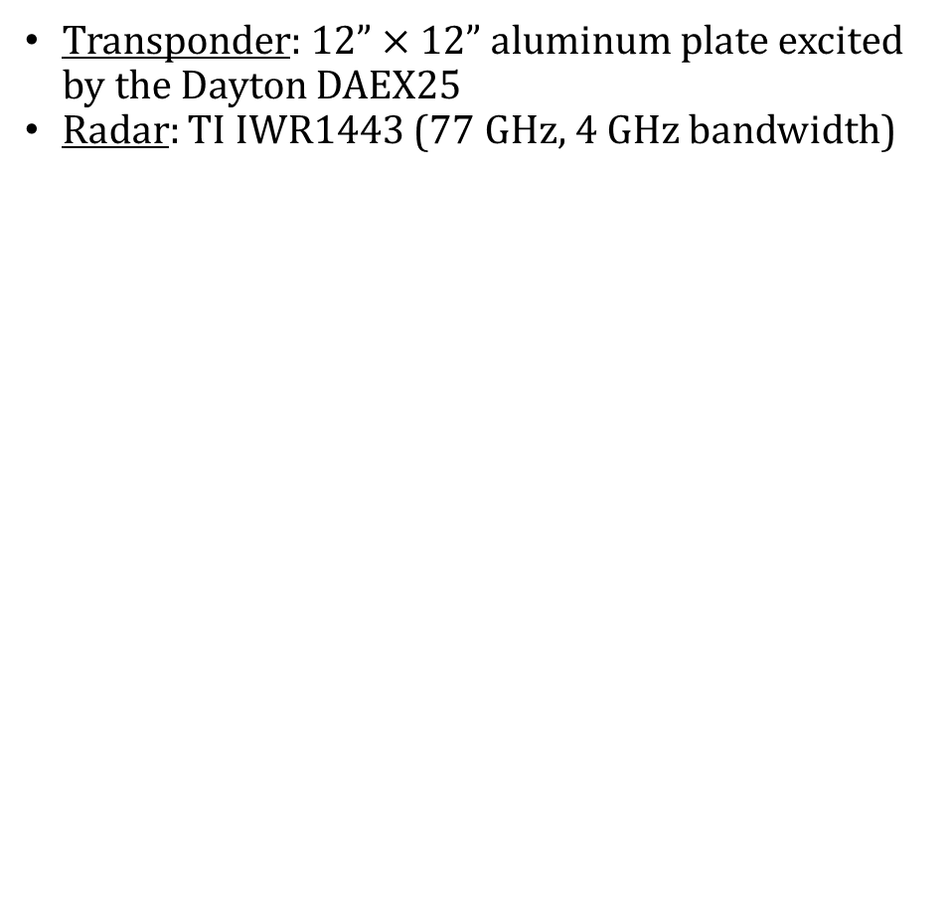
VRBC Data Acquisition Description
Transponder: $12”×12”$aluminum plate excited by the Dayton DAEX25
Radar: TI IWR1443 (77 GHz, 4 GHz bandwidth)
^{[2]}
Notes:
Aluminum plate = $15
Dayton DAEX25 = $12

Slide 14
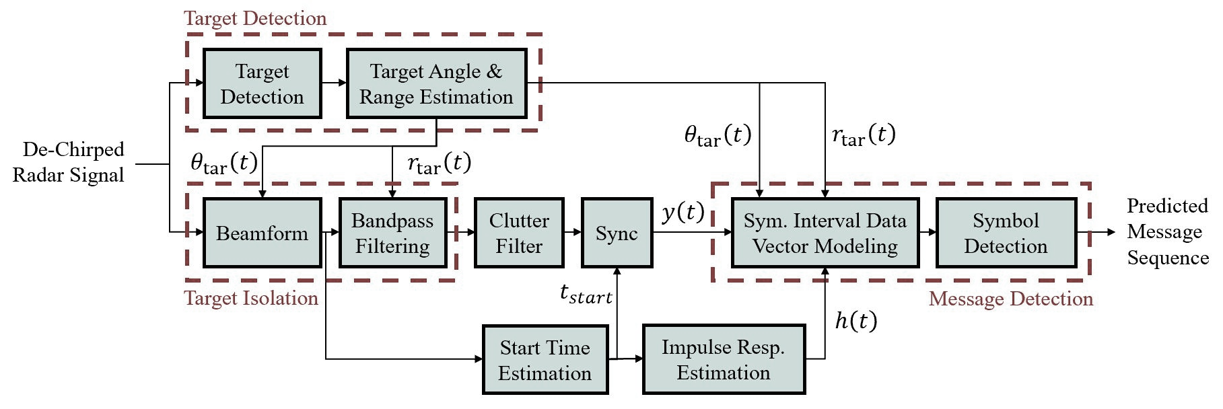
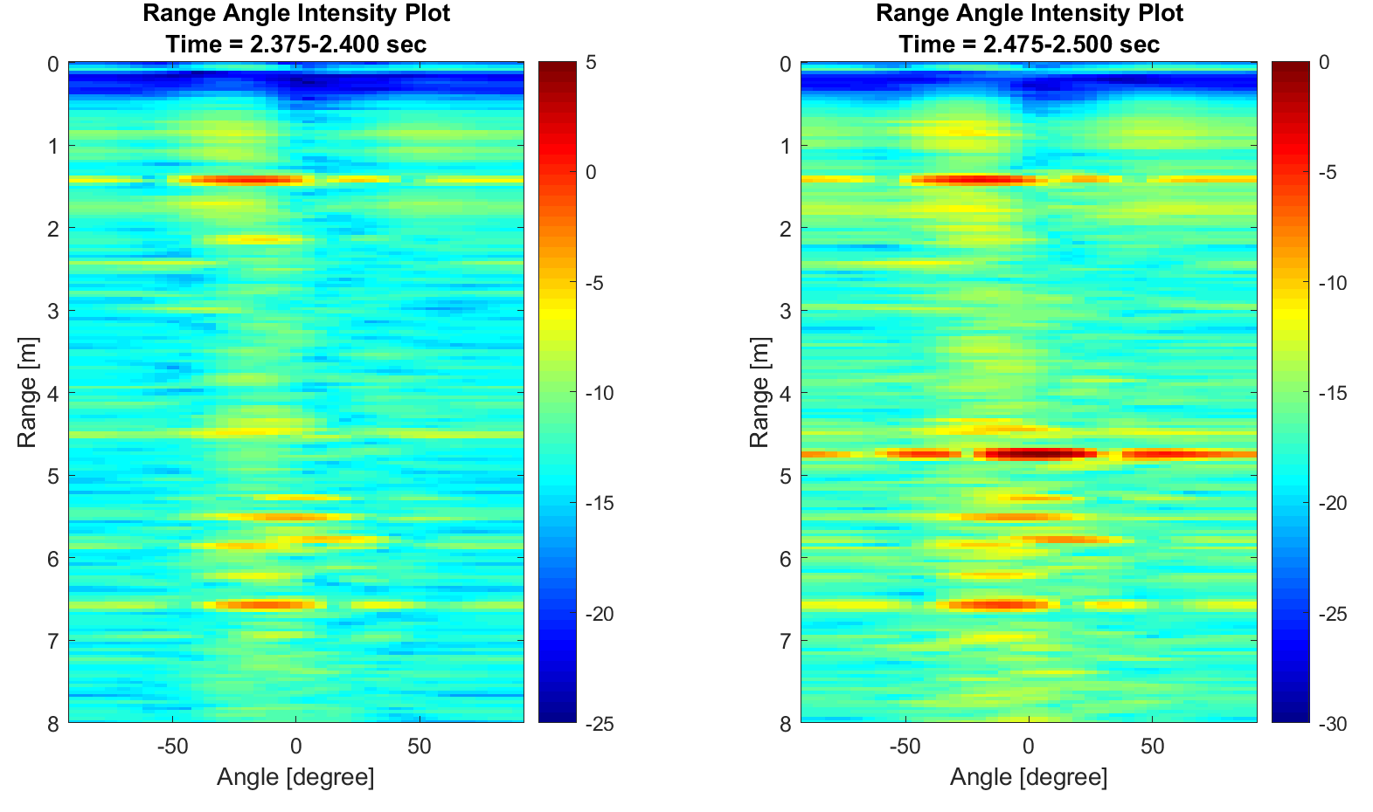
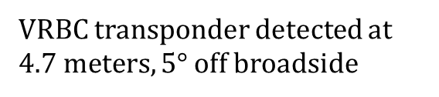
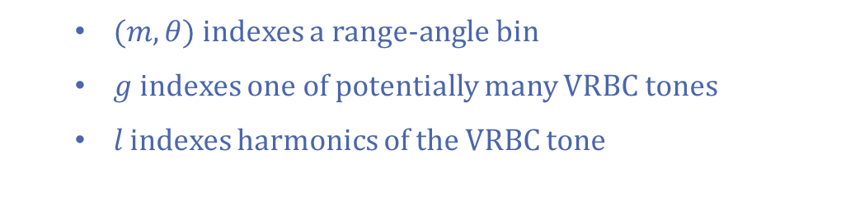
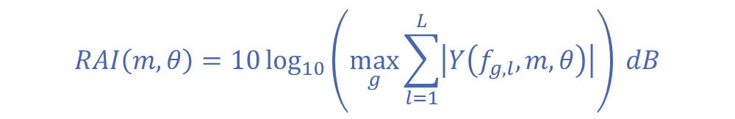
Detecting VRBC Transponders
Conventional CFAR will detect anything in range-Doppler-angle space with a significant power compared to resolution cells around it.
VRBC detection must be constrained to look for VRBC-specific Doppler content.
Consider the power at Doppler cells at integer multiples of the Doppler frequency of the peak under test.
Range-Angle Intensity
Prior to VRBC Sequence
Range-Angle Intensity
During VRBC Sequence
$$RAI\left(m,θ\right)=10\log_{10}\left(\max_{g}{\sum_{l=1}^{L}{\left|Y\left(f_{g,l},m,θ\right)\right|}}\right) dB$$
$(m,θ)$indexes a range-angle bin
$g$ indexes one of potentially many VRBC tones
𝑙 indexes harmonics of the VRBC tone
VRBC transponder detected at $4.7 meters, 5°$ off broadside

Slide 15
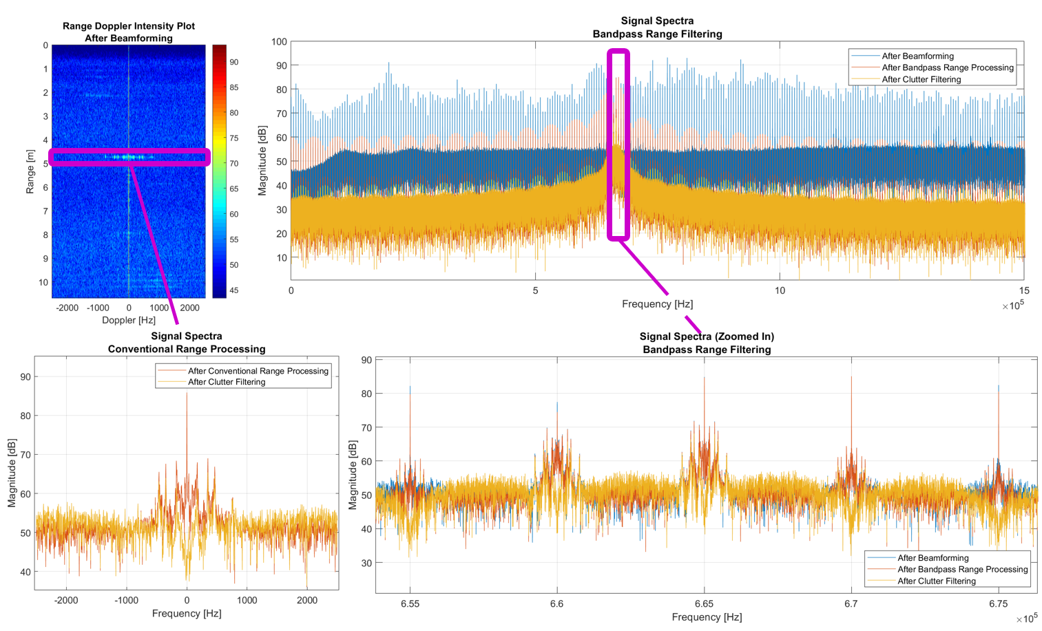
Isolating VRBC Transponders
differs from traditional range-Doppler processing to include all fast-time samples
range isolation is now accomplished using BPF
vibrational Doppler remains captured at non-dominant, range bin-associated PRF carriers

Slide 16
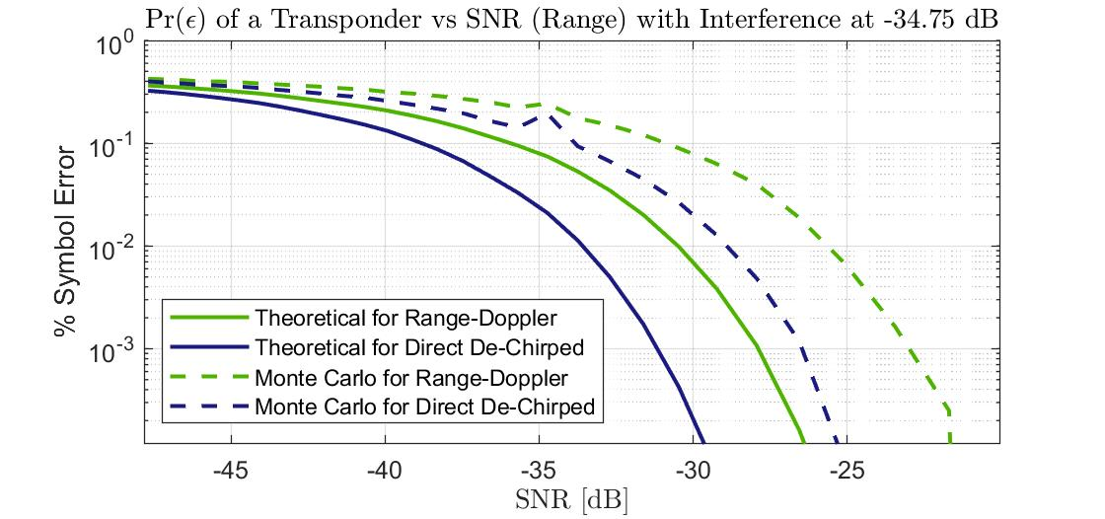
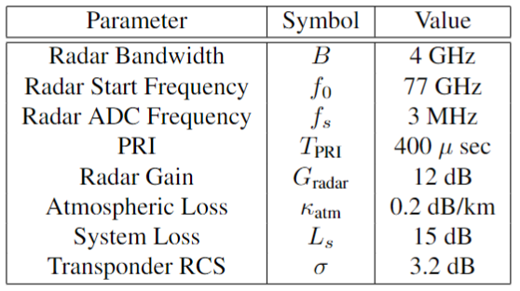
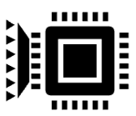
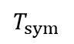
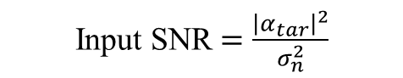
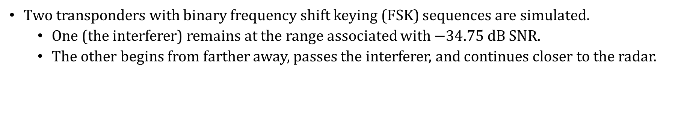
Justifying Using the Direct De-Chirped Signal for Range Processing Using Simulations
Two transponders with binary frequency shift keying (FSK) sequences are simulated.
One (the interferer) remains at the range associated with $−34.75$dB SNR.
The other begins from farther away, passes the interferer, and continues closer to the radar.
Input SNR $=\frac{{\left|α_{tar}\right|}^{2}}{σ_{n}^{2}}$
more samples = more energy
% Symbol Error
% Symbol Error
Symbol Length
$$T_{sym}$$
2 msec
Input SNR [dB]
Input SNR [dB]
farther from the radar
closer to the radar
range
transponder
of interest
stationary interfering transponder
mmW radar

Slide 17

Clutter Filtering
Typically achieved with a notch filter at the clutter ridge in slow-time/Doppler.
Requires space-time adaptive processing (STAP) for complex interference.
Recall, that a tone also likely results in significant power at the clutter ridge.
Filtering out transponder return in this manner is fine for detection, but not for displacement estimation.
Shallow Clutter
Filtered Phasor
Deep Clutter
Filtered Phasor
assuming a known displacement signal, clutter filtering effects can be known but will likely distort phase
Original Phasor

Slide 18






Towards More Ideal Clutter Filtering
To avoid phase errors in estimating displacements, better clutter filtering is required.
Resembles narrowband FM phasor diagrams → constant modulus algorithm (CMA)? ^{[74, 75]}
Conventional CMA requires prior knowledge of the modulus radius, ie. transponder power.
Performance function:
$$J_{k}=\frac{1}{2}𝔼\left[{\left(\left|y_{out}\left[k\right]\right|−𝔼\left[\left|y_{out}\left[k\right]\right|\right]\right)}^{2}\right]$$
with
$$y_{out}\left[k\right]=y_{in}\left[k\right]+A\left[k\right]\left(e^{{jθ}_{k}}−e^{jφ\left[k\right]}\right)$$
where $A\left[k\right]=\left|y_{in}\left[k\right]\right|+γ_{k}$
and $φ\left[k\right]=𝔼$ $\left[∠y_{in}[k]\right].$
Simple gradient search provides updates
$$θ_{k+1}=θ_{k}−μ_{θ}∇_{θ}J_{k}$$
$$γ_{k+1}=γ_{k}−μ_{γ}∇_{γ}J_{k}$$

Slide 19



Synchronizing Sequences of Unknown Displacements
Conventional cross-correlation requires knowing displacement.
Model transponding surfaces as LTI:
$$d\left(t\right)=x(t)⊗h(t)$$
MSC estimates the extent to which one signal can be predicted from the other using a linear model.
Results in a peak at all preamble frequencies at the start time
Used a preamble chirp from $\left[0,\frac{PRF}{2}\right]$
Slices at symbol frequencies will reveal decaying characteristics.

Slide 20



Transponder Impulse Response Estimation
Using the cross-spectral system ID method ^{[70]}, the impulse response of the system can be obtained:
$H\left(f\right)=\frac{S_{xd}\left(f\right)}{S_{xx}\left(f\right)}$
$$h\left(t\right)=ℱ^{−1}\{H\left(f\right)\}$$
Estimate is asymptotically unbiased assuming statistically independent additive zero-mean Gaussian noise.
Transponder Natural Freq.
$\left[60, 176, 322, 447, 764\right]$ Hz

Slide 21


Summary of Processing Prior to Message Decoding
Known return can be well-modeled from transponder estimates.
Transponder Detection → $r_{tar}, v_{tar}, {v_{radar}, θ}_{tar}$
Synchronization → $t_{start}$
Impulse Response Estimation →$h(t)$
symbol length = 0.02 sec

Slide 22








Modeling Symbol Data Vectors for Decoding
Symbol displacements are calculated using known excitations and the estimated impulse response
$$d\left(t\right)=h(t)⊗\sum_{q=1}^{Q}{x_{q}\left(t−qT_{PRI}\right)}$$
with excitation signals $x_{q}∈𝒳$ where $\left|𝒳\right|=M$
Top Level Symbol Progression
input symbol
data vectors
predicted symbol
$$m_{q}$$
$$y_{q}$$
$${\hat{m}}_{q}$$
$$y_{tar}\left(t\right)=\sum_{n=0}^{N}{w_{n}}\left({\tilde{α}}_{tar}e^{j2πf_{0}τ_{tar}\left(t+nT_{PRI}\right)}\sum_{g=0}^{G−1}{z_{tar}\left(t−\left(g−n\right)T_{PRI}\right)}\right)$$
where$w_{n}$ is the clutter filter coefficient for the $n^{th}$ tap
Data vectors:
$a_{q}$: noise-free data vector consisting of samples of $y_{tar}(t)$ for $\left(q−1\right)T_{PRI}≤t<qT_{PRI}$
$η_{q}$: BPF AWGN
$$y_{q}=a_{q}+η_{q}$$

Slide 23










Maximum Likelihood Detection
Let $a_{q}^{(m)}$ denote when the noise-free data vector
is derived from $x_{q}$ being the $m^{th}$ symbol.
These results aren’t great… because the transponder’s impulse response demonstrates extreme resonance.
[Recall from my Prelim] Using similar $T_{sym}$ and a less resonant surface (loudspeaker), single symbol ML gave near perfect detection at kbits rates though only at short ranges.
Calculating Rate
$${\hat{m}}_{q}=arg\max_{m}{Pr(m_{q}=m)}e^{−{\left(y_{q}−a_{q}^{\left(m\right)}\right)}^{H}Γ^{−1}\left(y_{q}−a_{q}^{\left(m\right)}\right)}$$
$$R_{obs}=\frac{H\left({\hat{m}}_{q}\right)−H\left({\hat{m}}_{q} | m_{q}\right)}{T_{sym}}$$
Detected Symbol, ${\hat{m}}_{q}=n$
$$H\left({\hat{m}}_{q}\right)=−\sum_{n}{\left(\frac{\sum_{m}{C_{m,n}}}{Q}\right)\log_{2}\left(\frac{\sum_{m}{C_{m,n}}}{Q}\right)}$$
0.96 | 0.04 | 0.00 | 0.00
0.03 | 0.31 | 0.03 | 0.63
0.04 | 0 | 0.75 | 0.21
0.10 | 0 | 0.16 | 0.74
$$H\left({\hat{m}}_{q}|m_{q}\right)=\sum_{n}{\left(\frac{\sum_{m}{C_{m,n}}}{Q}\right)}H\left({\hat{m}}_{q} | m_{q}=m\right)$$
$$m_{q}=m$$
True Symbol
$$H\left({\hat{m}}_{q} | m_{q}=m\right)=−\sum_{n}{\left(\frac{C_{m,n}}{\sum_{n}{C_{m,n}}}\right)\log_{2}\left(\frac{C_{m,n}}{\sum_{n}{C_{m,n}}}\right)}$$
Rate $≈48.7$ bps

Slide 24



Handling Resonant Transponding Surfaces
Resonant surfaces lead to larger displacements but also ISI.
To use small $T_{sym}$, we must utilize sequence detection and/or coding constraints
Model all possible symbol interval displacements due to ISI or coding constraints.
Can require defining a negligible amount of ISI for modeling
Describe the displacement sequence as a Markov model.
States: defined by ISI
Transitions: defined by a new symbol occurrence
Transition Matrix: dependent on ISI and coding constraints
Use the Viterbi algorithm to detect the most likely sequence.
Detected Symbol
1 | 0 | 0 | 0
0 | 1 | 0 | 0
0 | 0.07 | 0.93 | 0
0.05 | 0.23 | 0.14 | 0.59
True Symbol
Rate $≈80.0$ bps

Slide 25



How Resonant means Sequence Detection is Worthwhile?
Consider two transponders with impulse responses that only vary in decay factor.
$M=3$, $T_{sym}=5$ msec, number of symbol intervals required to decay before negligible per symbol $=\left\{2,1,1\right\}$, no-consecutive symbols coding constraint

Slide 26












An Upper Bound on VRBC Rate
$$R=\frac{I\left({\hat{m}}_{q};m_{q}\right) }{T_{sym}}=\frac{H\left({\hat{m}}_{q}\right)−H\left({\hat{m}}_{q} | m_{q}\right)}{T_{sym}}$$
condition probabilities are intricate if symbol data vectors aren’t orthogonal
Mutual Information Rate:
Data Processing Inequality:
Because
$M$-ary upper bound on rate:
$$R≤ \frac{h\left(y_{q}\right)−h\left(y_{q} | m_{q}\right)}{T_{sym}}$$
$$h\left(y_{q}\right)=−\int{f\left(y_{q}\right)}\log_{2}{f\left(y_{q}\right)}dy_{q}$$
no analytical solution for the differential entropy of a homoscedastic (same covariance) complex Gaussian mixture
$f\left(y_{q}\right)=\sum_{i∈D}{Pr\left(a_{q}=a^{(i)}\right)}$ $f\left(y_{q}|a_{q}=a^{(i)}\right)$
where $D$ is the set of displacements dependent on $m$(symbol) and $s$ (state/ISI)
Using a lower bound for the expected value of a log-sum^{[72, 73]}:
$$h\left(y_{q}\right)≤h\left(y_{q} | a_{q}\right)−\sum_{iεD}{Pr\left(a_{q}=a^{(i)}\right)}\log_{2}\left(ζ_{i}\right)$$
$$ζ_{i}=\sum_{i^{′}∈D}{Pr\left(a_{q}=a^{(i^{′})}\right)2^{−β_{i,i^{′}}}}$$
$$β_{i,i^{′}}={\left(a^{\left(i\right)}−a^{\left(i^{′}\right)}\right)}^{H}Γ^{−1}\left(a^{\left(i\right)}−a^{\left(i^{′}\right)}\right)$$
where
and
$$R≤−\sum_{iεD}{\frac{Pr\left(a_{q}=a^{\left(i\right)}\right)}{T_{sym}}}\log_{2}\left(ζ_{i}\right)=R_{KL UB}$$
If $\left|D\right|>M,$ high SNRs lead to $R_{KL UB}>R_{M−ary UB}$
$h\left(y_{q} | m_{q}\right)≥h\left(y_{q} | a_{q}\right)$:
$$R≤−\sum_{m}{\frac{Pr\left(m_{q}=m\right)}{T_{sym}}}\log_{2}\left(Pr\left(m_{q}=m\right)\right)=R_{M−ary UB}$$
$$R≤\min{\{R_{KL UB}},R_{M−ary UB}\}$$
Notes:
The actual rate calculation becomes complex to solve directly, as non-orthogonal symbols lead to complex conditional probabilities.
Can’t calculate the differential entropy of y_q exactly because it is a complex, homoscedastic Gaussian mixture (a long standing problem).

Slide 27



Anticipated Vehicle Noise
Accelerometer ($f_{s}=100$ Hz) data collection on hybrid Kia Sportage
Noise mitigation methods like that in [78] are used. (See dissertation and/or back-up slides).
Accelerating from 40-60 mph
Takeaways
Most vehicle noise is $<40$ Hz.
Technical literature agrees and claims vibrations $<1$ mm amplitude. ^{[76, 77]}
Noise at multiple locations on a vehicle is correlated.
One can be used to mitigate vibrational effects at the other.
Gas mode generates additional tonal noise inversely related to speed.
Accelerating from 40-60 mph

Slide 28





















How can mmW Radar Vibrometry help Vehicles Communicate?
Existing X2V^{[23]}
VRBC
$$>300 m$$
Max
$< 300$m
Range
dependent on transponder RCS
Data
$≈$ kbps
$$3−27 Mbps$$
Rates
improvements expected with better coding/transponder design
Number of
$$>> 7$$
$$7$$
Channels
dependent on
spatial resolution
warning
Conclusion
In places where mmW sensing is already used like in vehicles, VRBC serves as an affordable, scalable, and low latency communication solution that requires no additional RF spectrum usage.
$2$ ms
Comm.
Latency
No handshaking technically needed
RF transceivers
Required
Add-Ons
Vibrating transponder
$70$ MHz
RF
Spectrum
No additional

Slide 29

What are the Key Take Aways?
Novel Communication System – Vibrational Radar Backscatter Communication
Potential Impact
affordable, scalable, and low-latency communication system that requires no additional RF spectrum when mmW sensing is already present like in connected vehicles
Description of Work
1. conceived of a new backscatter comms. system that observes modulated surface vibrations from a transponder
2. developed a comprehensive signal model and processing chain to detect, isolate, and decode VRBC transponders
3. simulated and implemented VRBC to demonstrate practicality and provide initial solutions to application-motivated challenges
Key Results
theoretical and experimental proof of system and signal processing chain capabilities
demonstrated $100$ bps performance at $5$ meters and justified kbps performance at longer ranges through simulations
significant rate improvement using application-motivated methods like sequence detection for resonant transponding surfaces

Slide 30
Future Work
Vibrational Radar Backscatter Communication
Iterative joint transponder and messaging scheme optimization
Improved retro-directivity
Increased number of desirable signal symbols (tenths of millimeter vibrational displacement, orthogonal data vectors, minimal interference, … )
Minimizing acoustic noise
Considering non-FSK messaging schemes
Implementation of vibrational noise canceling methods
mmW Vibrometry
Refined clutter filtering methods
Improved minimization of negative phase effects during clutter filtering
Increase robustness in cases of platform bulk movements
Evaluate allowable mmW radar phase noise for successful phase estimation

Slide 31
Acknowledgements
Advisor:
Dr. Jeffrey Krolik
Committee:
Dr. Loren Nolte, Dr. Robert Calderbank, Dr. Stacy Tantum, and Dr. Donald Bliss
Current Lab Members:
Dr. Michael Martinez, Shannon Pinnell, Elliot Mueller, and Dr. Granger Hickman
Previous Lab Members:
Dr. Anil Ganti and Dr. Andrew Young
Family and Friends
Especially my parents Terry and Jeannie Bilskie and my husband Aaron Centers

Slide 32
Questions?

Slide 33


Radar Vibrometry for Non-Acoustic Speech Analysis
Motivated by its relation to vital signs monitoring ^{[33-36]}, mmW radar vibrometry captures throat vibrations to capture speech generation information.
Our Approach: Evaluate the mmW radar’s ability to capture larynx speech-induced vibrations and consider its use in speech-based applications.

Slide 34




mmW Radar vs LDV Larynx Vibration Measurements
Motivated by its relation to vital signs monitoring, mmW radar vibrometry captures throat vibrations to capture speech generation information.
ALE
1
2
3
4
5
Conventional delay-and-sum beamformer.
Consists of a fast-time DFT and capturing the complex
amplitude across a range bin.
Uses standard notch filtering in slow-time.
Adaptive line enhancer (ALE) using recursive least squares (RLS) with $50$ taps and a delay of $10$.
Short-time Fourier Transform (STFT) with $20$ msec window length with Taylor window and $70\%$ overlap.
Recall that vibrometry data without phase estimation is the Bessel function result.
Vibrometry appears to be approximately LPF acoustic data.

Slide 35




Biometric Identification with Vibrometry-Like Data
Due to scarcity of mmW vibrometry data, LPF TIMIT ^{[43]} acoustic data was first used.
Inspired by [44-46], our speaker ID system was
1
2
3
4
5
6
7
8
Mel scale features measure subjective pitch according to human ear’s hearing ability.
STFT in Mel scale using Python’s Librosa library, $64$ length filter bank, window length of $20$ msec, $95\%$overlap
Convolutional layer with $5×5$ kernel and stride $=2$
Max pool with $2×2$ kernel
Convolutional layer with $3×3$ kernel and stride $=1$
Convolutional layer with $3×3$ kernel and stride $=1$
Multi-task learning using other targets in the TIMIT database.
$$loss_{full}=0.8 loss_{Speaker ID}+0.1 loss_{Dialect Region}+{0.1}_{Gender}$$

Slide 36


Speech Recognition vs Speaker ID for LPF Audio
Automatic speech recognition (ASR) requires multiple observations of different people speaking the same words.
TIMIT database consists every person speaking ten phonetically rich sentences.
Adopted Google Speech Recognition ^{[48]} yet recognized as a lower bound on performance as it was trained on non-filtered acoustic data.
ASR requires first harmonic to recognize speech perhaps.
Speaker ID requires less of the high harmonics of speech to perform well.

Slide 37



Can mmW Radar Vibrometry Lead to Novel Speech Analysis Systems?
If LPF audio with ca cutoff of $1$ kHz does equation well to mmW vibrometry data, speaker ID systems could be made more contextually private.
However, further work is required to justify
mmW radar vibrometry data set of larynx vibrations for multiple speakers saying multiple word utterances
an ASR trainable on non-acoustic data
unobtainable

Slide 38

What are the Key Take Aways?
Preliminary Analysis of Non-Acoustic Speech Systems – Context-Blind Speaker ID
Potential Impact
mmW vibrometry could provide a data source related to human speech generation to offer contextually private biometric identification
Description of Work
1. used mmW radar larynx vibrometry data to generate speech spectrograms similar to those often generated from acoustic data for speech analysis systems
2. evaluated the performance of different variants of data in both a speaker ID and speech recognition system
Key Results
less than $10$ dB of SNR depreciation for the first two harmonic of speech when using mmW radar vibrometry vs LDV
greater than $40\%$ better performance in speaker ID than speech recognition for LPF audio data that resembles mmW radar vibrometry
Future Work
Content-Blind Speaker ID
mmW radar vibrometry data set creation for human larynx vibrations during speech generation
Thorough speaker ID vs ASR performance analysis using vibrometry-trained models

Slide 39


Bibliography

Slide 40




Bibliography

Slide 41


Bibliography

Slide 42




Bibliography

Slide 43




Bibliography

Slide 44


Bessel Function Result for Vibrational Power
Slow-time signal at a particular fast-time range bin for a vibrating target
$$y_{slow−time}\left(t,m\right)≈{\tilde{α}}_{tar}e^{j2πf_{0}τ_{tar}(t)}+\tilde{n}(t)$$
Plug in a tonal vibration and assume no bulk movement without loss of generality
$$y_{slow−time}\left(t,m\right)≈{\tilde{α}}_{tar}e^{j\frac{4π}{λ_{0}} (r_{tar}+γsin⁡(2πf_{d}t))}+\tilde{n}(t)$$
Take its Fourier transform
$$Y_{slow−time}\left(f,m\right)≈{\tilde{α}}_{tar}e^{j\frac{4π}{λ_{0}} r_{tar}}\sum_{l=0}^{∞}{J_{l}}\left(\frac{4π}{λ_{0}}γ\right) δ\left(f−lf_{d}\right) +\tilde{N}(f)$$

Slide 45

Swerling Model for Radar Return Gain/Attenuation Terms
Gain/Attenuation terms are complex Gaussian with a uniformly random phase and variance related to the radar equation
$f\left(∠{\tilde{α}}_{obj}\right)=\left\{\begin{matrix}\frac{1}{2π} & −π≤∠{\tilde{α}}_{obj}<π \\ 0 & otherwise\end{matrix}\right.$ $f\left(\left|{\tilde{α}}_{obj}\right|,σ\right)=\frac{\left|{\tilde{α}}_{obj}\right|}{σ^{2}}e^{−\frac{{\left|{\tilde{α}}_{obj}\right|}^{2}}{2σ^{2}} }$ for $\left|{\tilde{α}}_{obj}\right|≥0$
$𝔼\left[{\left|{\tilde{α}}_{obj}\right|}^{2}\right]=\frac{4−π}{2}σ^{2}=\left(\frac{G_{TX}}{4πr_{obj}^{2}}\right)\left(\frac{σ_{obj}}{4πr_{obj}^{2}}\right)\left(\frac{1}{L_{s}L_{a}\left(r_{obj}\right)}\right)A_{eff}$
$A_{eff}=\frac{λ_{0}^{2}}{4π}G_{RX}$, $L_{a}\left(r_{obj}\right)={10}^{κ r_{obj}/5000}$ with $κ=0.2 dB/km$
TI IWR1443 gains and losses:
$G_{RX}=48 dB$, $P_{TX}=12 dBm$, $L_{s}=8 dB$, noise figure$=15 dB$,

Slide 46

Transponder Design Considerations
Cost, size, and power: relative to the application of interest
Noise pollution: displacing surfaces leads to sound unless vacuum sealed to limit energy losses to material loss rather than acoustic radiation
Reflectivity:
$𝔼\left[{\left|{\tilde{α}}_{obj}\right|}^{2}\right]=\left(\frac{G_{TX}}{4πr_{obj}^{2}}\right)\left(\frac{σ_{obj}}{4πr_{obj}^{2}}\right)\left(\frac{1}{L_{s}L_{a}\left(r_{obj}\right)}\right)A_{eff}$
SNR $=\frac{𝔼\left[{\left|{\tilde{α}}_{obj}\right|}^{2}\right]}{σ_{n}^{2}}$, $A_{eff}=\frac{λ_{0}^{2}}{4π}G_{RX}$, $L_{a}\left(r_{obj}\right)={10}^{κ r_{obj}/5000}$
For a flat $12”×12”$aluminum plate with $σ_{obj}=\frac{4πh^{2}w^{2}}{λ_{0}^{2}}$ and reflectivity $≈0.98$,
SNRs of $[−10, 0, 10]$dB equate to distances of $[335, 188, 106]$meters.
Ability to be controlled exactly: to avoid ISI and achieve closer to orthogonal data vectors
Provides ample displacement: resonant surfaces → larger displacement
more symbols with larger displacement → higher rates
ratio of TX power incident upon object
ratio of power reflected back
losses due to the system and atmosphere
effective aperture size of antenna(s)

Slide 47
A Look at Other Solutions in Connected Vehicles
Vehicle-to-vehicle (V2V) Communication
Dedicated Short Range Communication (DSRC)
Cellular Vehicle-to-Anything (C-V2X)
Cooperative Sensing
Uses spectrum sensing to reactively avoid same-band operation
Joint Radar-Communication (JRC)
Modulating radar waveforms to contain a communication message
Joint Communication-Radar (JCR)
Using a communication signal with good ambiguity function for sensing
Unified Codesign
Coexistence/
Cohabitation
Sharing Spectrum
Cooperation
Performance
Tradeoffs
Between Systems
Codesign

Slide 48





Why Conventional Backscatter Comm. at mmW isn’t Practical
Traditional backscatter communications modulates via transponder impedance.
Challenges of mmW Backscatter Communication :
Path loss at higher frequencies requires mmW RFID to use complex, expensive antenna designs to return sufficiently strong signals
12 ``
0.9 GHz LoRa ~$0.2
24 GHz $μ$strip patch array
TI 77 GHz automotive radar ~$25
Notes:
LoRa (long range) backscatter comms: reaching km distances, has been considered for V2X
microstrip patch antenna array: additively manufactured with inkjet printing using silver nanoparticle inks on a flexible liquid-crystal polymer substrate making it “low cost”, gigabit-data-rate at 24 GHz

Slide 49


Narrowband Frequency Modulated (FM) Phasors
Assume message signal, $m(t)$
The frequency of FM signal, $f\left(t\right)=f_{c}+A_{m}m\left(t\right)$
The phase is therefore, $θ\left(t\right)=2π\int_{0}^{t}{f_{c}+A_{m}m\left(τ\right)dτ}=2πf_{c}t+{2πA}_{m}\int_{0}^{t}{m\left(τ\right)dτ}$
Full signal becomes, $y\left(t\right)=A_{c}\cos{(2πf_{c}t+{2πA}_{m}\int_{0}^{t}{m\left(τ\right)dτ})}$
$y\left(t\right)=A_{c}\cos\left(2πf_{c}t\right)\cos\left({2πA}_{m}\int_{0}^{t}{m\left(τ\right)dτ}\right)−A_{c}\sin\left(2πf_{c}t\right)\sin\left({2πA}_{m}\int_{0}^{t}{m\left(τ\right)dτ}\right)$
Narrowband FM means that ${2πA}_{m}\int_{0}^{t}{m\left(τ\right)dτ}$ remains small… much less than $2π$.
Assume $\cos\left({2πA}_{m}\int_{0}^{t}{m\left(τ\right)dτ}\right)≈1$ and $\sin\left({2πA}_{m}\int_{0}^{t}{m\left(τ\right)dτ}\right)≈{2πA}_{m}\int_{0}^{t}{m\left(τ\right)dτ}$
$y\left(t\right)≈A_{c}\cos\left(2πf_{c}t\right)−2πA_{c}A_{m}\left(\int_{0}^{t}{m\left(τ\right)dτ}\right)\sin\left(2πf_{c}t\right)$

Slide 50



Modifier CMA for Clutter Filtering
Performance function looks to minimize the variance of the amplitude, $J_{k}=\frac{1}{2}𝔼\left[{\left(\left|y_{out}\left[k\right]\right|−𝔼\left[\left|y_{out}\left[k\right]\right|\right]\right)}^{2}\right]$
Allows a translation around a circle of magnitude $A\left[k\right]$ to negate difference in bulk angle of the clutter versus transponder, $y_{out}\left[k\right]=y_{in}\left[k\right]+A\left[k\right]\left(e^{{jθ}_{k}}−e^{jφ\left[k\right]}\right)$ where $φ\left[k\right]=$ $𝔼\left[∠y_{in}[k]\right]$
Allows the amplitude $A\left[k\right]$ to adaptively adjust to negate remaining clutter effects and allow for some changes in transponder power over time, $A\left[k\right]=\left|y_{in}\left[k\right]\right|+γ_{k}$
Use previous $N$ samples to estimate expected values.
Using gradient descent both adaptive variables are updated via
$$θ_{k+1}=θ_{k}−μ_{θ}∇_{θ}J_{k}$$
$$γ_{k+1}=γ_{k}−μ_{γ}∇_{γ}J_{k}$$
$$γ_{k}$$
$$θ_{k}$$

Slide 51

Modifier CMA for Clutter Filtering, cont.
$$θ_{k+1}=θ_{k}−μ_{θ}∇_{θ}J_{k}$$
$$γ_{k+1}=γ_{k}−μ_{γ}∇_{γ}J_{k}$$
Let $B\left[k\right]=𝔼[{|y}_{out}[k]|]=\frac{1}{N}$ $\sum_{p=0}^{N−1}{\left|y_{out}\left[k−p\right]\right|}$
$$∇_{θ}J_{k}=\frac{1}{N}\sum_{n=0}^{N−1}{\left(\left|y_{out}\left[k−n\right]\right|−B\left[k−n\right]\right)\left(\frac{y_{out}\left[k−n\right]}{\left|y_{out}\left[k−n\right]\right|}∇_{θ}y_{out}\left[k−n\right]−∇_{θ}B\left[k−n\right]\right)}$$
where $∇_{θ}y_{out}\left[k−n\right]=−A\left[k−n\right]e^{jθ_{k}}$ and$∇_{θ}B\left[k−n\right]=\frac{1}{N}\sum_{p=0}^{N−1}{\frac{y_{out}\left[k−n−p\right]}{\left|y_{out}\left[k−n−p\right]\right|}∇_{θ}y_{out}\left[k−n−p\right]}$
$$∇_{γ}J_{k}=\frac{1}{N}\sum_{n=0}^{N−1}{\left(\left|y_{out}\left[k−n\right]\right|−B\left[k−n\right]\right)\left(\frac{y_{out}\left[k−n\right]}{\left|y_{out}\left[k−n\right]\right|}∇_{γ}y_{out}\left[k−n\right]−∇_{γ}B\left[k−n\right]\right)}$$
where $∇_{γ}y_{out}\left[k−n\right]=e^{jθ_{k}}−e^{jφ[k−n]}$ and$∇_{θ}B\left[k−n\right]=\frac{1}{N}\sum_{p=0}^{N−1}{\frac{y_{out}\left[k−n−p\right]}{\left|y_{out}\left[k−n−p\right]\right|}∇_{γ}y_{out}\left[k−n−p\right]}$

Slide 52






Putting VRBC Return into a Markov Model
$$N=\{2,1,1\}$$
Consider three FSK symbol example
$T_{sym}=0.01 sec$
Symbol intervals required to decay out to “negligible”
Symbol 1 = 2
Symbol 2 = 1
Symbol 3 = 1
Coding constraint is no consecutive symbols.

Slide 53


Why VRBC Benefits from Orthogonal Noise-Free Data Vectors
Probability of misclassifying one symbol, $a^{(s_{1})}$, for another, $a^{(s_{2})}$, is
$$Pr\left(l_{s_{2}}>l_{s_{1}} | a^{\left(s_{1}\right)}\right)$$
where
$$l_{s_{i}}=Pr\left(s=s_{i}\right)e^{−{\left(y−a^{\left(s_{i}\right)}\right)}^{H}Γ^{−1}\left(y−a^{\left(s_{i}\right)}\right)}.$$
If $y=a^{\left(s_{1}\right)}+η$, numerator contains term
$${\left(a^{\left(s_{1}\right)}−a^{\left(s_{i}\right)}\right)}^{H}\left(a^{\left(s_{1}\right)}−a^{\left(s_{i}\right)}\right)$$
$$={a^{\left(s_{1}\right)}}^{H}a^{\left(s_{1}\right)}−2Re({a^{\left(s_{1}\right)}}^{H}a^{\left(s_{i}\right)})+{a^{\left(s_{i}\right)}}^{H}a^{\left(s_{i}\right)}$$
$l_{s_{i}}$ for $i≠1$ → term is maximized if ${a^{\left(s_{1}\right)}}^{H}a^{\left(s_{i}\right)}=0$(orthogonal)
$l_{s_{i}}$ for $i=1$ → term is $0$

Slide 54



Proving the Lower Bound on the Expected Value of a Log-Sum

Slide 55


Mitigating Vehicle Noise
Radar Platform Noise Mitigation^{[78]}
Estimate platform noise using slow-time signal from clutter points.
$$y\left(t,r_{m},θ_{m}\right)={\tilde{α}}_{clt}e^{j\frac{4π}{λ_{0}}\left(r_{m}−d_{n}\left(t\right)−v_{radar}t\right)}+\tilde{n}(t)$$
$$s_{r_{m},θ_{m}}\left(t\right)=−∠y\left(t,r_{m},θ_{m}\right)+\frac{4π}{λ_{0}}\left(r_{m}−v_{radar}t\right)$$
$${\hat{d}}_{n}\left(t\right)=\frac{λ_{0}}{4π}\frac{1}{M}\sum_{m=1}^{M}{\frac{s_{r_{m},θ_{m}}\left(t\right)}{\cos{θ_{m}}}}$$
Cancel clutter at all beam-range combinations of interest.
$${\hat{d}}_{n,θ_{p}}\left(t\right)={\hat{d}}_{n}\left(t\right)θ_{p}$$
$$\hat{y}\left(t,r_{m},θ_{p}\right)=y\left(t,r_{m},θ_{p}\right)e^{j{\hat{d}}_{n,θ_{p}}\left(t\right)}$$
Transponder Platform Noise Mitigation
Estimate platform noise using slow-time signal from target platform points w/o transponder
$$y\left(t,r_{m},θ_{m}\right)={\tilde{α}}_{clt}e^{j\frac{4π}{λ_{0}}\left(r_{m}−d_{n}\left(t\right)−v_{radar}t\right)}+\tilde{n}(t)$$
$$s_{r_{m},θ_{m}}\left(t\right)=−∠y\left(t,r_{m},θ_{m}\right)+\frac{4π}{λ_{0}}\left(r_{m}−v_{radar}t\right)$$
$${\hat{d}}_{n}\left(t\right)=\frac{λ_{0}}{4π}\frac{1}{M}\sum_{m=1}^{M}{\frac{s_{r_{m},θ_{m}}\left(t\right)}{\cos{θ_{m}}}}$$
Use platform noise estimate in data vector model.
$${\hat{d}}_{n,θ_{p}}\left(t\right)={\hat{d}}_{n}\left(t\right)θ_{p}$$
$$τ_{tar}^{(m,s)}\left(t\right)=\frac{2}{c}\left(r_{tar}+v_{tar}t−v_{radar}t+d^{(m,s)}\left(t\right)−{\hat{d}}_{n}(t)\right)$$
$a^{(m,s)}=$ $y_{tar}^{(m,s)}\left(t\right)$ for $\left(q−1\right)T_{PRI}≤t<qT_{PRI}$
$$y_{tar}^{(m,s)}\left(t\right)={\tilde{α}}_{tar}e^{j2πf_{0}τ_{tar}^{(m,s)}\left(t\right)}\sum_{g=0}^{G−1}{z_{tar}\left(t−gT_{PRI}\right)}$$

Slide 56

Texas Instruments IWR1443 mmW Radar

